Slide 1
COMP 3500 Introduction to Operating Systems Project 4 – Processes and System Calls Overview
Dr. Xiao Qin
Auburn University http://www.eng.auburn.edu/~xqin
xqin@auburn.edu
Notes:
Cont. Lec08c-Deadlock Detection Slides 15-19
40 Minuets:

Slide 2
Project Objectives
To collaborate with your group members using CVS
To start building a multi-tasking operating system
To develop system calls to manage processes
To develop system calls to manage file system states
Use GDB to debug OS/161
Three weeks to achieve the above objectives!

Slide 3
How to collaborate?
Naming global variables
A consistent way of writing function and variable names
How often to commit changes to CVS?
Ensure a working version from CVS

Slide 4
Partnership
To manage your partnership
If you and your group members have difficulty working together, please talk with the TA or Dr. Qin
We will help your partnership work more effectively

Slide 5
Before add a file to CVS …
chmod 640 or chmod 644
A word about permissions:
0 = no operations allowed
1 = execute permission or the ability to cd in the case of a directory
2 = write permission
4 = read permission
Default value 711
Owner, Group Members, non-group members
Notes:
Your home directory will have permissions 711 by default. These permissions mean the following: 7 = 4+2+1:You (the owner) can read/write/execute 1 = 1:Other users in your group can cd/execute but not read or write 1 = 1:Other users not in your group can cd/execute but not read or write

Slide 6
To Build a Real Multi-tasking Operating System
In project 3, Cats-Mice program:
Functions linked into the kernel
Run inside the kernel
Reason? unable to run user-space code
Goal: Make OS/161 run user-space programs
Notes:
Your home directory will have permissions 711 by default. These permissions mean the following: 7 = 4+2+1:You (the owner) can read/write/execute 1 = 1:Other users in your group can cd/execute but not read or write 1 = 1:Other users not in your group can cd/execute but not read or write

Slide 7
Current Version
Reboot is the only working system call available to user-space code
The kernel does NOT understand what a process is
The kernel does NOT maintain any per-process state
Ninimal support for running executables
Objectives: Solve the above problems
Notes:
Your home directory will have permissions 711 by default. These permissions mean the following: 7 = 4+2+1:You (the owner) can read/write/execute 1 = 1:Other users in your group can cd/execute but not read or write 1 = 1:Other users not in your group can cd/execute but not read or write

Slide 8
Project 4 is a foundation for future projects …
OS/161 will to run multiple processes simultaneously from actual compiled programs
Programs will be loaded into your OS/161
Programs will be executed in user mode by the System/161.
Be controlled by your kernel and the command shell in bin/sh
Notes:
you have to implement the interface between user-mode programs ("userland") and the kernel. You will be provided part of the code needed for this assignment, and you are required to design and implement the missing pieces. Your job also includes implementation of the subsystem that keeps track of the multiple tasks you will have in the future. Importantly, you need to design data structures for "process" (Hint: look at kernel include files of your favorite operating system for suggestions,

Slide 9
Project 4 is a foundation for future projects …
To implement an interface between user programs and the kernel
System Calls
Notes:
you have to implement the interface between user-mode programs ("userland") and the kernel. You will be provided part of the code needed for this assignment, and you are required to design and implement the missing pieces. Your job also includes implementation of the subsystem that keeps track of the multiple tasks you will have in the future. Importantly, you need to design data structures for "process" (Hint: look at kernel include files of your favorite operating system for suggestions,

Slide 10
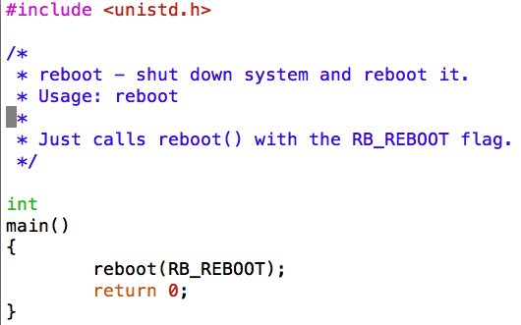
How does a user program work?
Existing User Programs
~/cs161/src/sbin
Reboot, halt, poweroff
Notes:
you have to implement the interface between user-mode programs ("userland") and the kernel. You will be provided part of the code needed for this assignment, and you are required to design and implement the missing pieces. Your job also includes implementation of the subsystem that keeps track of the multiple tasks you will have in the future. Importantly, you need to design data structures for "process" (Hint: look at kernel include files of your favorite operating system for suggestions,

Slide 11
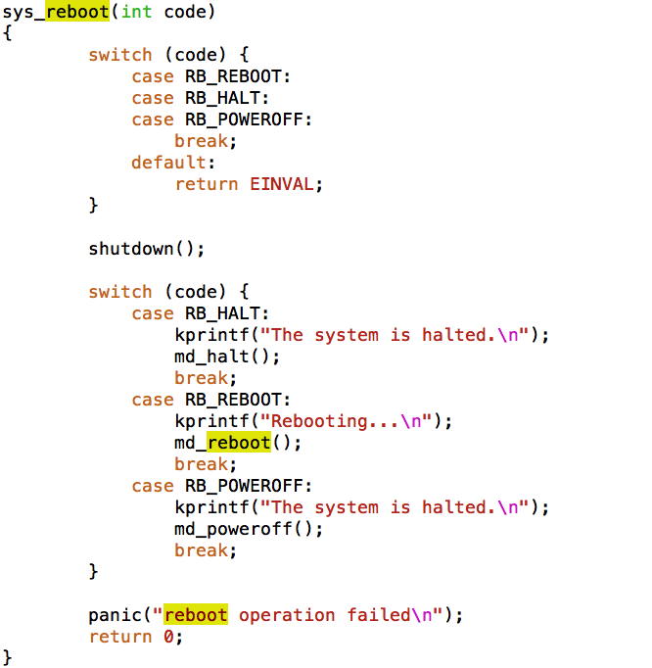
More about reboot
~/cs161/src/kern/main/main.c

Slide 12
How to run a user program?
Run normal programs compiled from C on the System/161 simulator
cs161-gcc
Notes:
you have to implement the interface between user-mode programs ("userland") and the kernel. You will be provided part of the code needed for this assignment, and you are required to design and implement the missing pieces. Your job also includes implementation of the subsystem that keeps track of the multiple tasks you will have in the future. Importantly, you need to design data structures for "process" (Hint: look at kernel include files of your favorite operating system for suggestions,

Slide 13
Task 1: Read Source Code
You do not need to submit your answers to these questions
You must make an effort to answer them.

Slide 14
Task 1: Read Source Code
kern/userprog: the user program
loadelf.c, runprogram.c, anduio.c
kern/arch/mips/mips: traps and syscalls
syscall.c: handles traps that happen to be syscalls
~/cs161/src/lib/crt0: user program startup
It invokes the user program's main()
Notes:
MPIS control executions

Slide 15
Task 2: Design Your Project
Who will be responsible for which parts of your implementation?
Data structures
Global and local variables
Algorithms for the system calls

Slide 16
Task 2: Sample Design Questions
What data structures will you need to manage multiple processes?
What relationships do your new data structures have with the OS/161?
How will you manage file accesses?
When the shell invokes the cat command, and cat starts to read file1, what will happen if another program also tries to read file1?
What would you like to happen?

Slide 17
Task 3-1: System Calls
open, read, write, lseek, close, dup2
getpid
fork, execv, waitpid, _exit

Slide 18
Task 3-2: System Calls
open(const char *path, int oflag, mode_t mode): It should be as simple as it seems.
read(int fd, void *buf, size_t nbytes): You can use struct uios, and make use you understand it. You also can check out VOP_READ.
write(int fd, const void *buf, size_t nbytes): Involves I/O to userland. You can use struct uios again. Please check out VOP_WRITE.

Slide 19
Task 3-2: System Calls
lseek(int fd, off_t offset, int whence): Can we always perform an lseek? For example, can we perform lseek() beyond the end of a file? Please use VOP_TRYSEEK.
close(int fd): It may be interesting because of the refcounting issue (think about garbage collection)!
dup2(int oldfd, int newfd): If newfd is already opened, close it. Upon successful completion, both file descriptors refer to the same file table object and share all properties of the object.

